Slide 1
Raspbot

Slide 2
Introduction
Raspbot: A Multitasking Robot
Low-budget yet highly versatile robotic system designed to perform a multitude of tasks efficiently and effectively.
Capabilities:
Virtual assistant functionality: Raspbot acts as a virtual assistant, assisting users with various tasks and queries
Interaction with users: With its interactive interface, Raspbot can respond to user commands and inquiries.
Object recognition: Using advanced computer vision algorithms, Raspbot can identify and classify various objects.
Distance measurement: Raspbot is capable of accurately measuring distances to objects using sensors.
QR code scanning: Raspbot can scan QR codes to access information or perform actions linked to the code.
Text recognition from images: Raspbot can extract text from images using optical character recognition (OCR) technology..
Real-time climate updates: Raspbot can provide up-to-date weather information for a given location.
Text translation: Raspbot can translate text between different languages, facilitating communication across language barriers.
Color detection: Raspbot can distinguish between different colors and provide feedback based on color input.

Slide 3
Scope of the Project
Current capabilities: Raspbot serves as a versatile assistant capable of assisting with tasks ranging from object identification to language translation.
Extends beyond more functionality, envisioning a dynamic platform for human-robot interaction.
However, the potential for enhancement and expansion is immense.
Future iterations could include features like obstacle avoidance, facial expressions, motion tracking, and more.
These advancements would not only augment the robot’s utility but also enrich its interactivity and engagement with users, paving the way for broader applications in various domains including education, entertainment, healthcare, and beyond.

Slide 4
Methodology
The methodology employed in developing this robotic system involves a blend of hardware integration, software development, and algorithmic implementation.
Beginning with the selection and assembly of hardware components such as Raspberry Pi, camera, ultrasonic sensor, servo motors, and peripherals, the focus shifts to software setup and configuration, utilizing Python programming language within the IDLE environment.
The core functionalities, including object detection, color recognition, text extraction, and QR code scanning, are implemented through a combination of computer vision algorithms, machine learning models, and API integrations.
Additionally, modules for weather reporting, translation services, and virtual assistance are integrated to enhance the robot’s utility and versatility.
Rigorous testing, debugging, and optimization ensure the robustness and reliability of the system, culminating in a comprehensive robotic platform ready for deployment and further refinement.

Slide 5
Materials used
It works on Python programming language to create a versatile robot using Raspberry Pi 4 Model B with 4GB RAM.
Utilizing hardware components like a camera, ultrasonic sensor, servo motors, wireless speaker, and mic, jumper wires, metal blocks for the skeleton, the project showcases the fusion of robotics, artificial intelligence, and human-computer interaction.

Slide 6
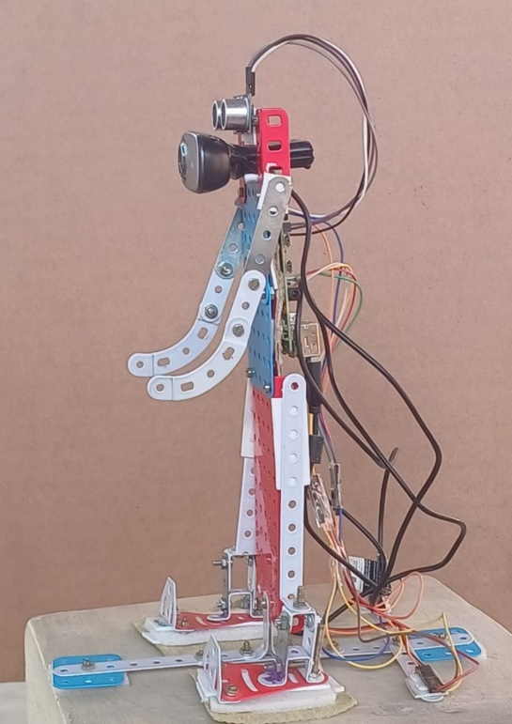
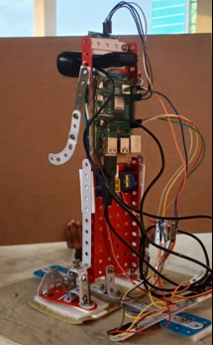
Photo of the product
View perspectives:
Raspberry Pi: Mounted on the chassis behind the camera, it serves as the robot's central processing unit, handling sensor data and motor control.
Sensors: Visible sensors include an ultrasonic sensor at the front and a gyroscope on the side, aiding in navigation. Wires: Connect various components together, facilitating communication and operation.

Slide 7
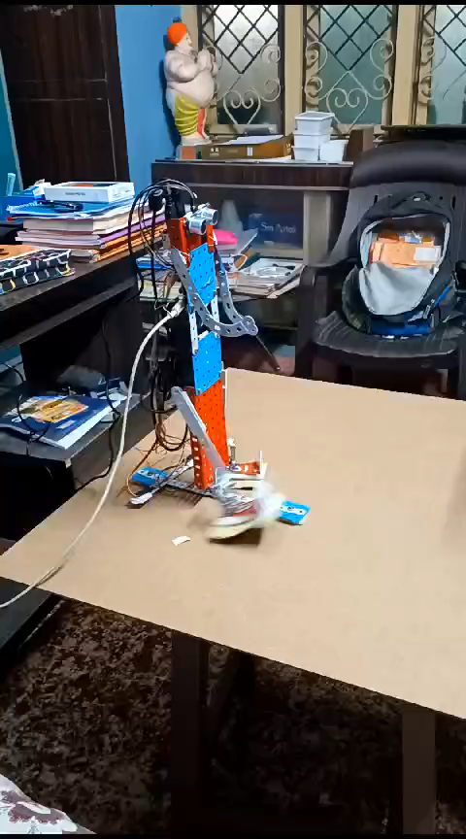
Result
Works Done
In the video presented It showcases the walking of our model Raspbot.
Excluding the video the Model can perform tasks like
Virtual assistance
Object recognition
Color detection
Interaction capabilities
Distance measurement
QR code scanning
Text recognition
Weather reporting
Translation services

Slide 8
Summary
Collaboration between robotics and artificial intelligence, presenting a versatile robot proficient in diverse tasks.
From object recognition to language translation it acts as a valuable assistant, fostering human-robot interaction and task automation.
This Model is a well performing and a Multitasking Robot which can be updated a lot in the future circumstances.
Extended version:
Aims to amplify the robot’s utility, interactivity, and applicability across domains.

